Slide 1
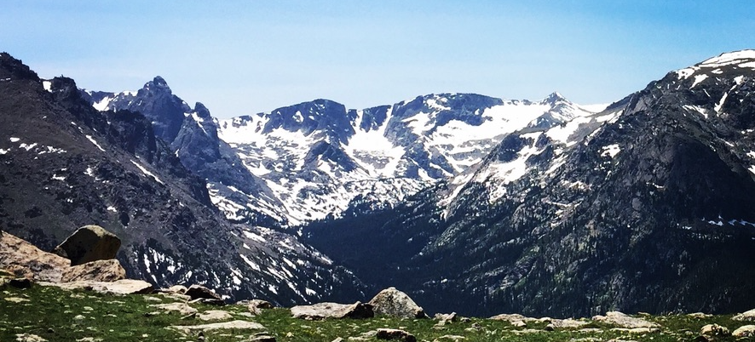
Welcome to ESCAPE!
UNM Earth Sciences Computing & Programming Experience
Aug 8 – 19, 2022
Instructors:
Eric Lindsey, Lindsay Worthington, Brandon Schmandt, Mousumi Roy, Jeng Hann Chong, Evans Onyango

Slide 2
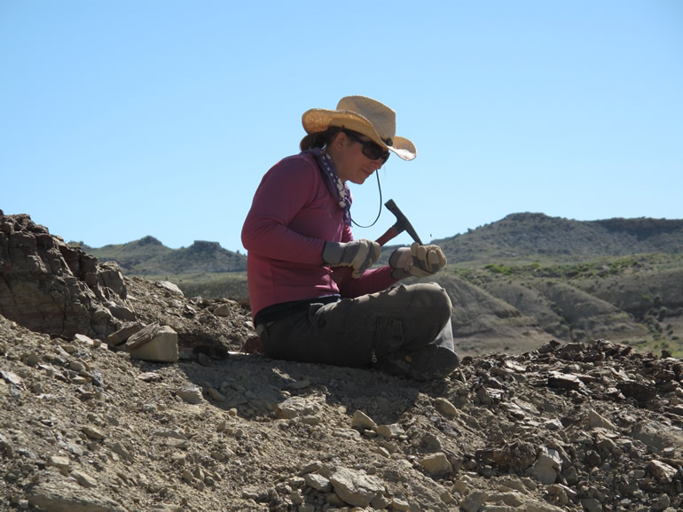
Why computing & programming in an Earth Sciences department?
What do you think of when you imagine an Earth Scientist at work?

Slide 3
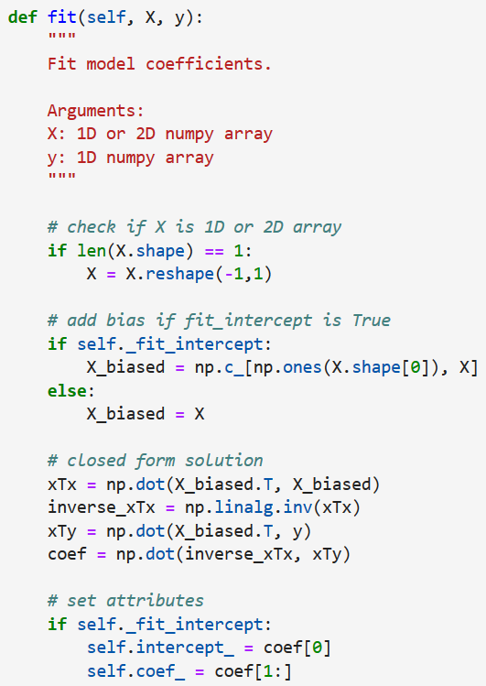
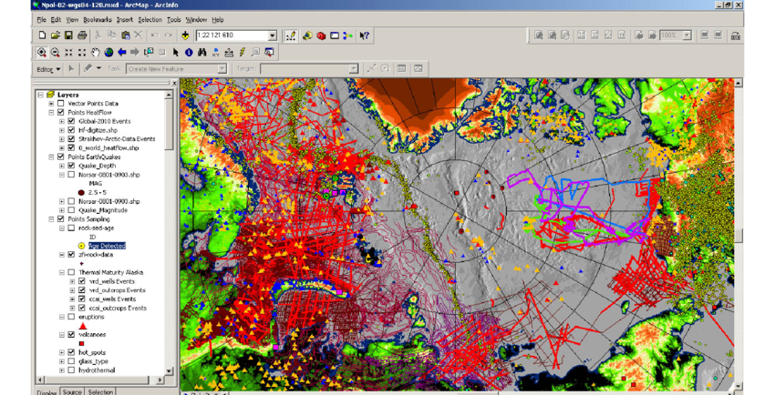
Why computing & programming in an Earth Sciences department?
What do you think of when you imagine an Earth Scientist at work?

Slide 4
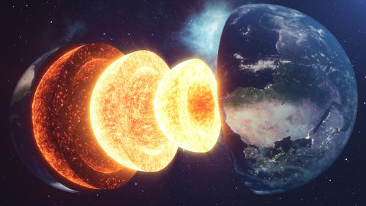
What is Geophysics?
The study of the physical processes on, inside and around the earth – From the core to the magnetosphere, and everything in between!
Geophysics is interdisciplinary – we use methods from the fields of geology, physics, chemistry, computer science, and others.
Over the next two weeks, we’ll learn about several important methods in geophysics, while gaining practice and confidence with programming.

Slide 5
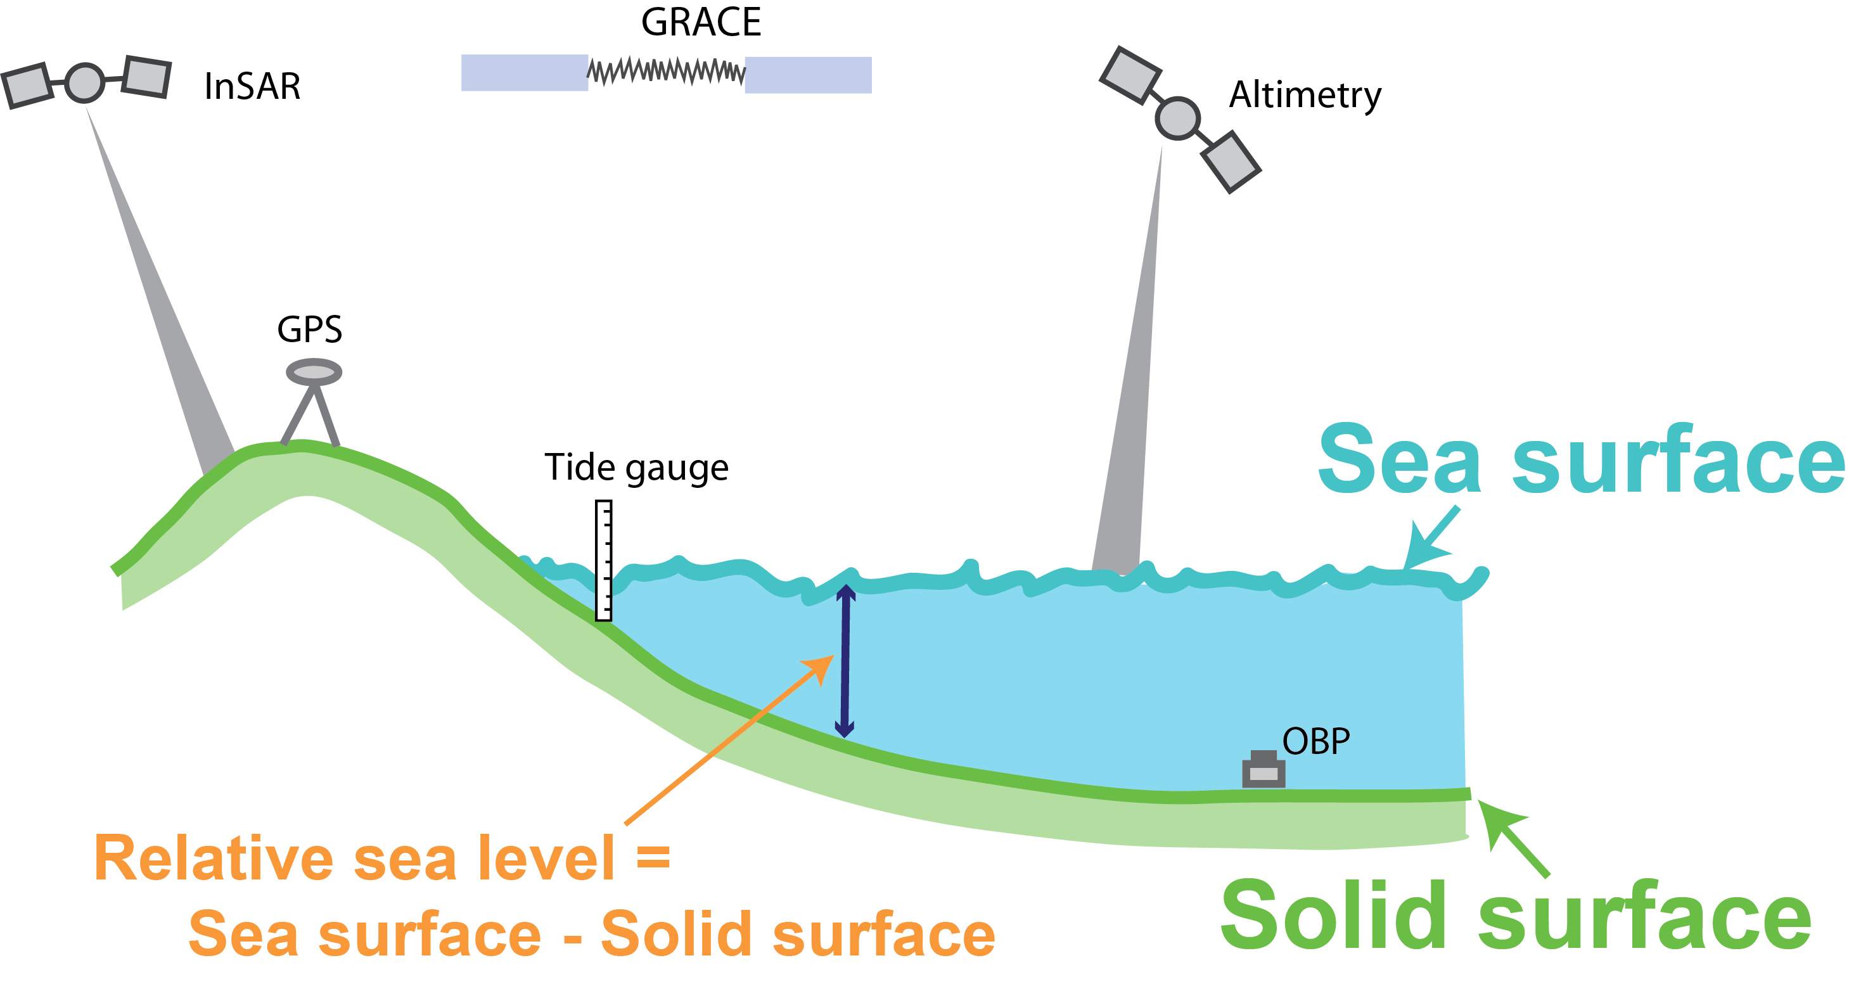
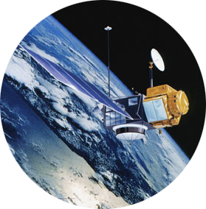
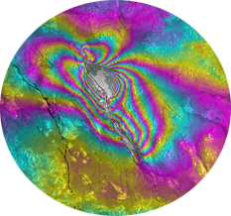
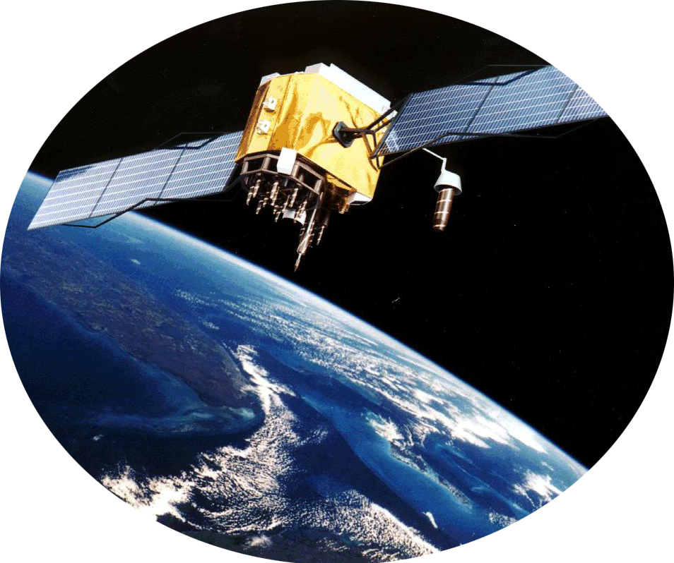
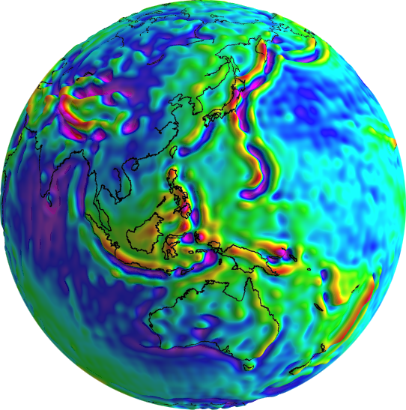
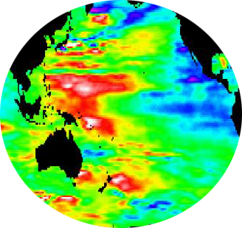
Geodesy: How do we measure the Earth’s shape?

Slide 6
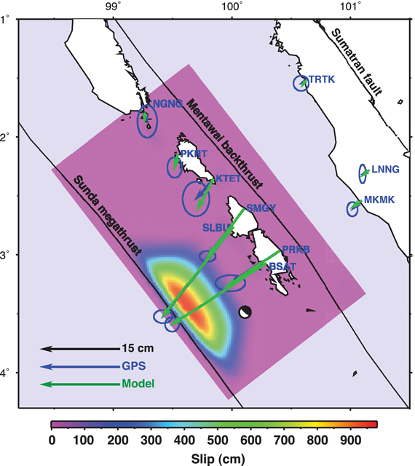
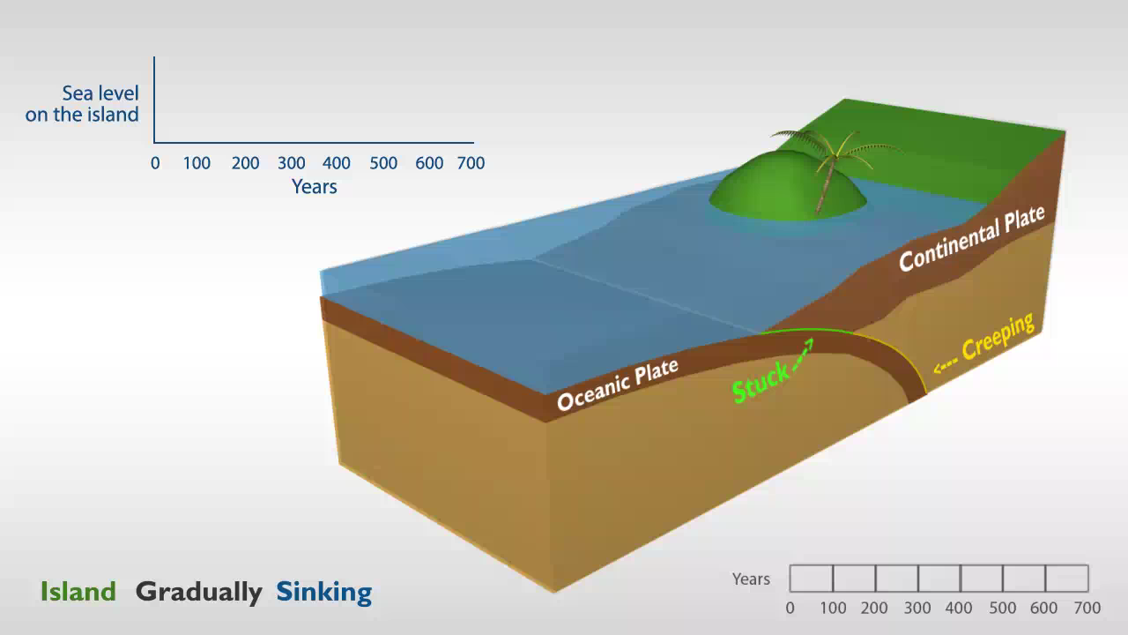
What can change the shape of the Earth?
Plate motions
Earthquakes and slip on faults
Volcano deformation
Groundwater and oil extraction
Hill et al., 2012: Displacements from the 2010 Mentawai earthquake as recorded by GPS

Slide 7
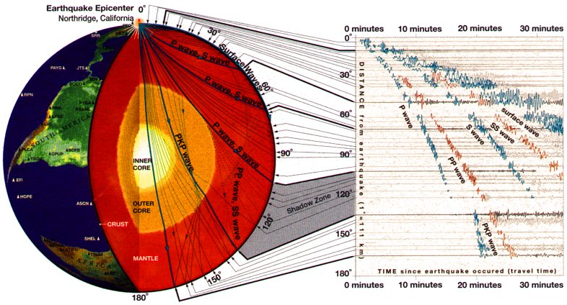
Seismology: how to see inside the earth
Reveal the Earth’s internal structure
Detect earthquakes – location, duration, magnitude, shape(?)
Understand the physical drivers of processes inside the earth
http://www.mgs.md.gov/seismic/education/no5.html

Slide 8
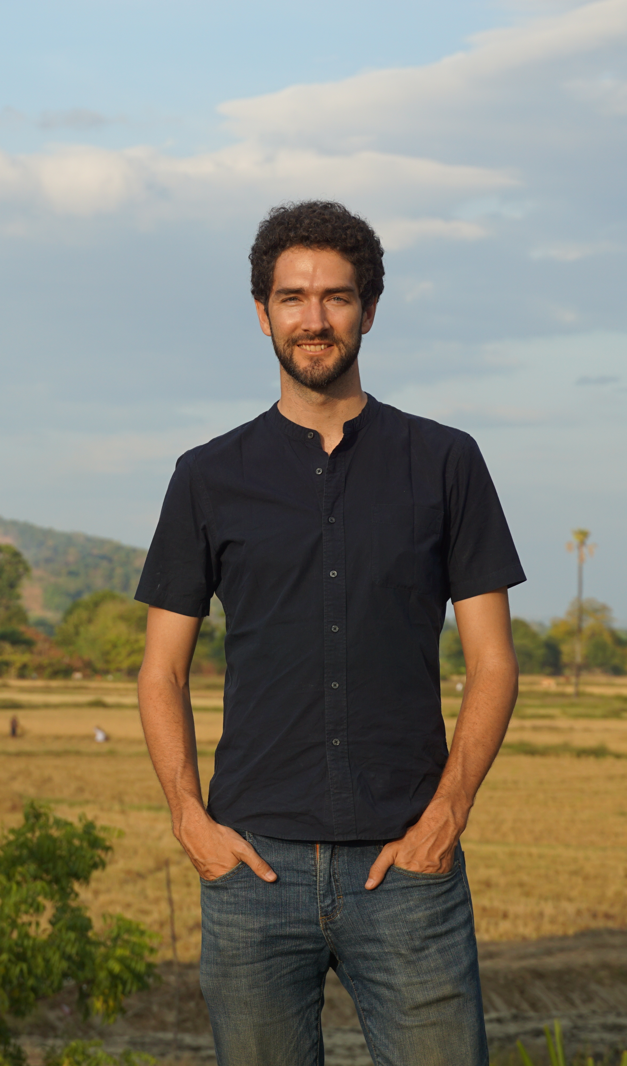
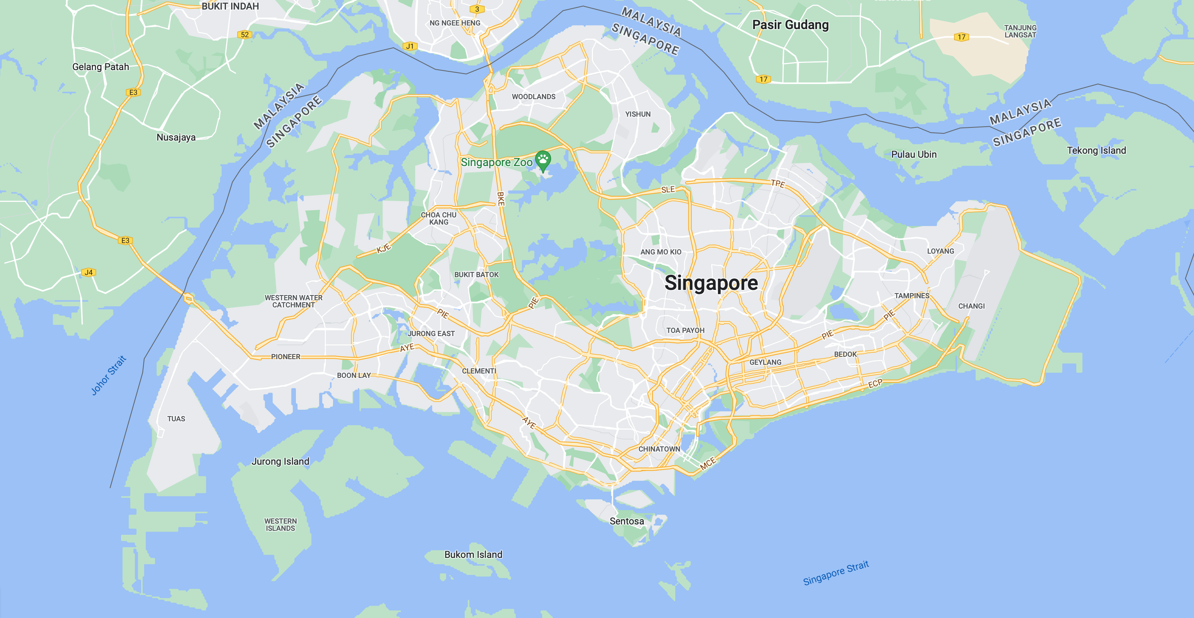
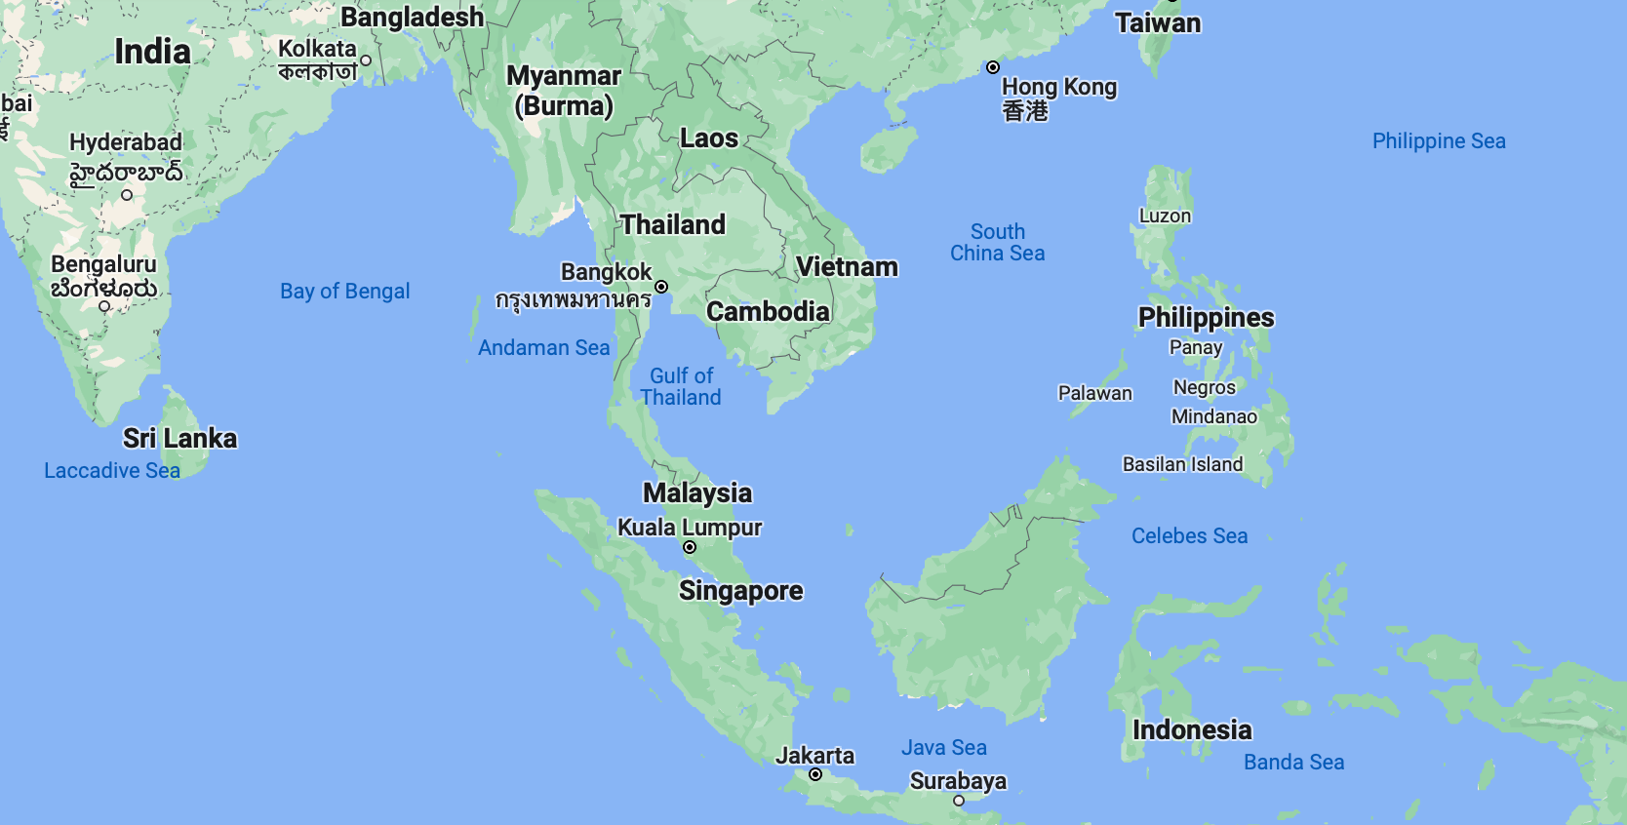
About your instructors
Eric Lindsey – Assistant Professor, EPS
Joined UNM in spring 2021 (during COVID!)
I use geodetic data to study plate tectonics, earthquakes, and other natural hazards.
I lived in Singapore from 2015 – 2020, where I studied tectonics and earthquakes around Southeast Asia.
5 miles

Slide 9
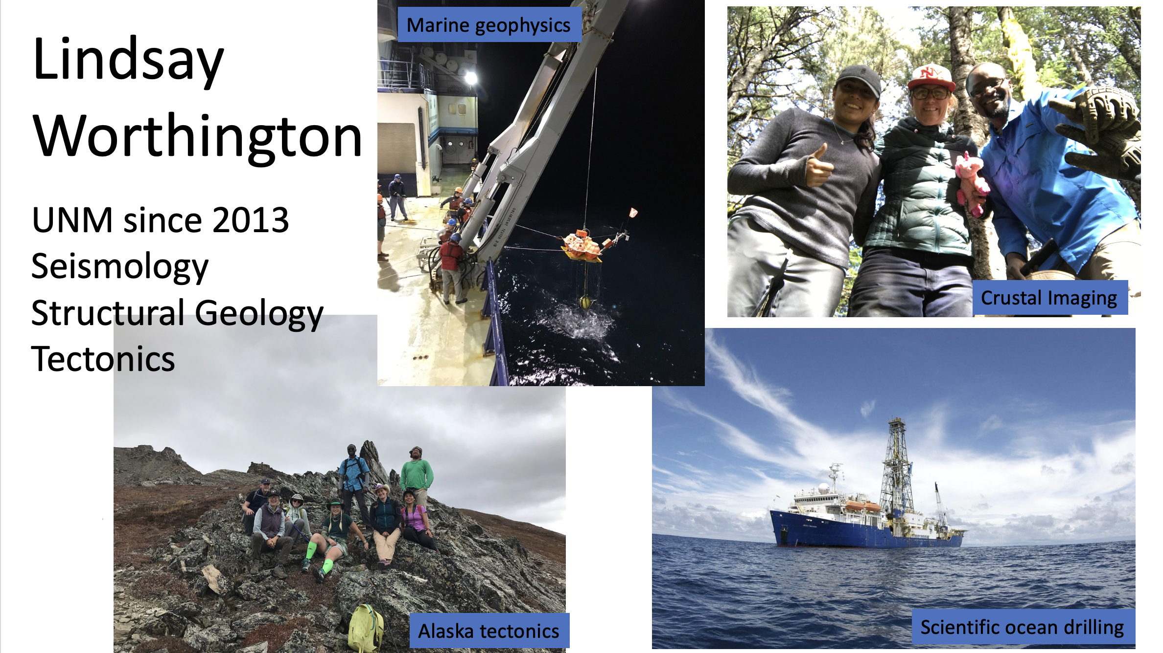
About your instructors
Associate Professor, Grad Admissions Chair, EPS

Slide 10
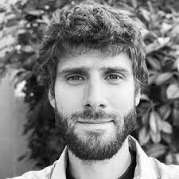
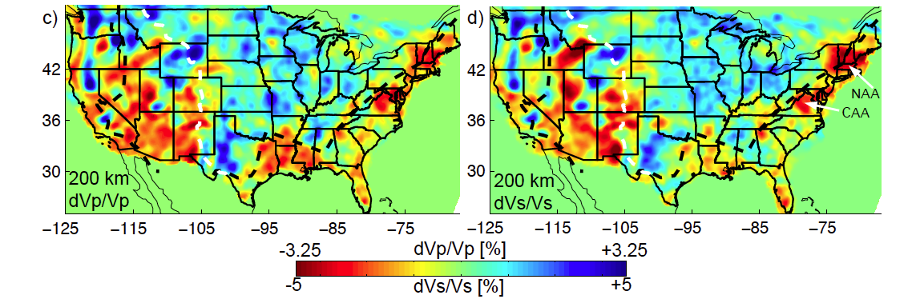
About your instructors
Brandon Schmandt – Professor, EPS
Seismology of the Earth’s crust and mantle
Seismic tomography and imaging
Earthquake source physics
Detection of unusual seismic sources
Schmandt & Lin, 2014

Slide 11
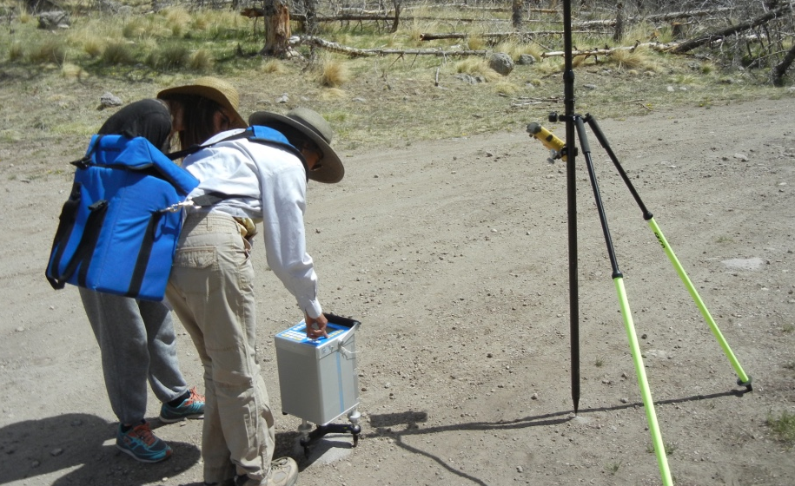
Mousumi Roy
Associate Professor, Physics and Astronomy
About your instructors
I first experienced an earthquake during elementary school, in the Philippines. It was transfixing...
I use physics and math to answer questions about Earth dynamics. Most recently: fluid dynamics, chemistry, heating during the transport of magma through the continental tectonic plates
At UNM since 1998, faculty since 2000 (first in EPS, then in PandA)

Slide 12
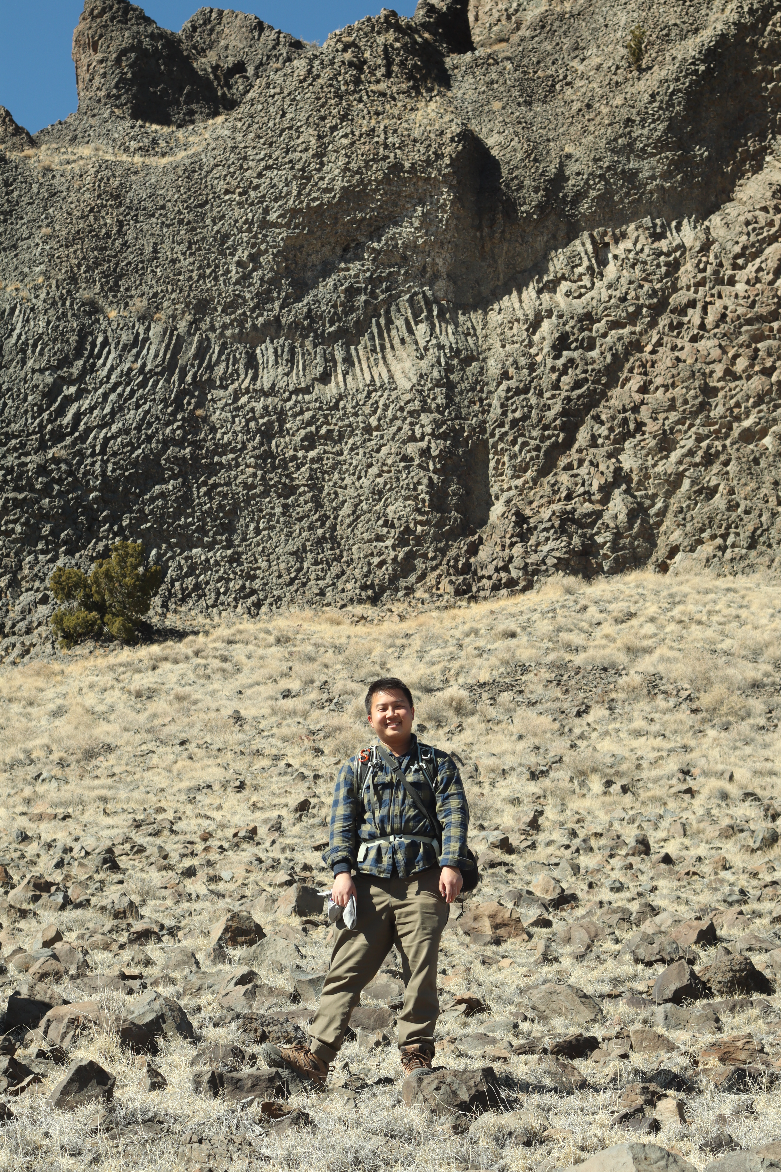
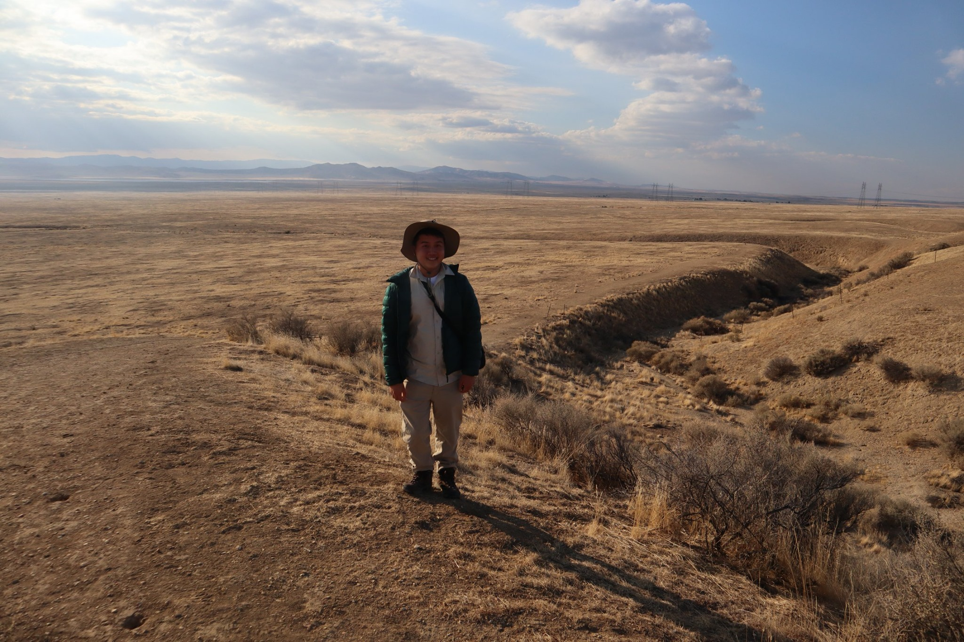
About your instructors
Jeng Hann, Chong – Graduate Student, EPS
Started at UNM in 2021
Focuses on tectonics (earthquakes) and mass wasting events (landslides, debris flows)

Slide 13
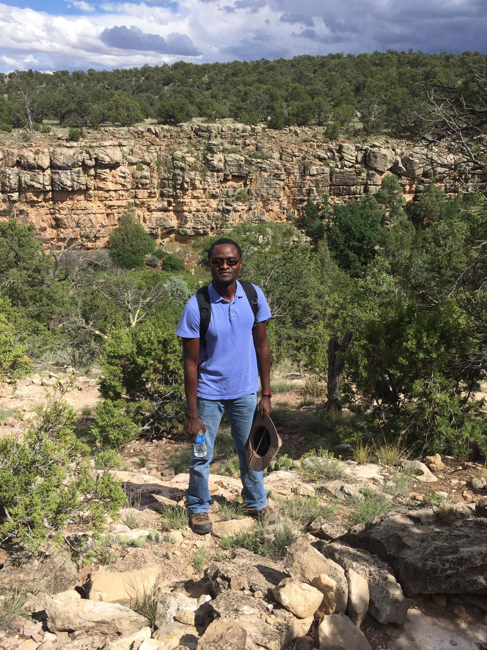
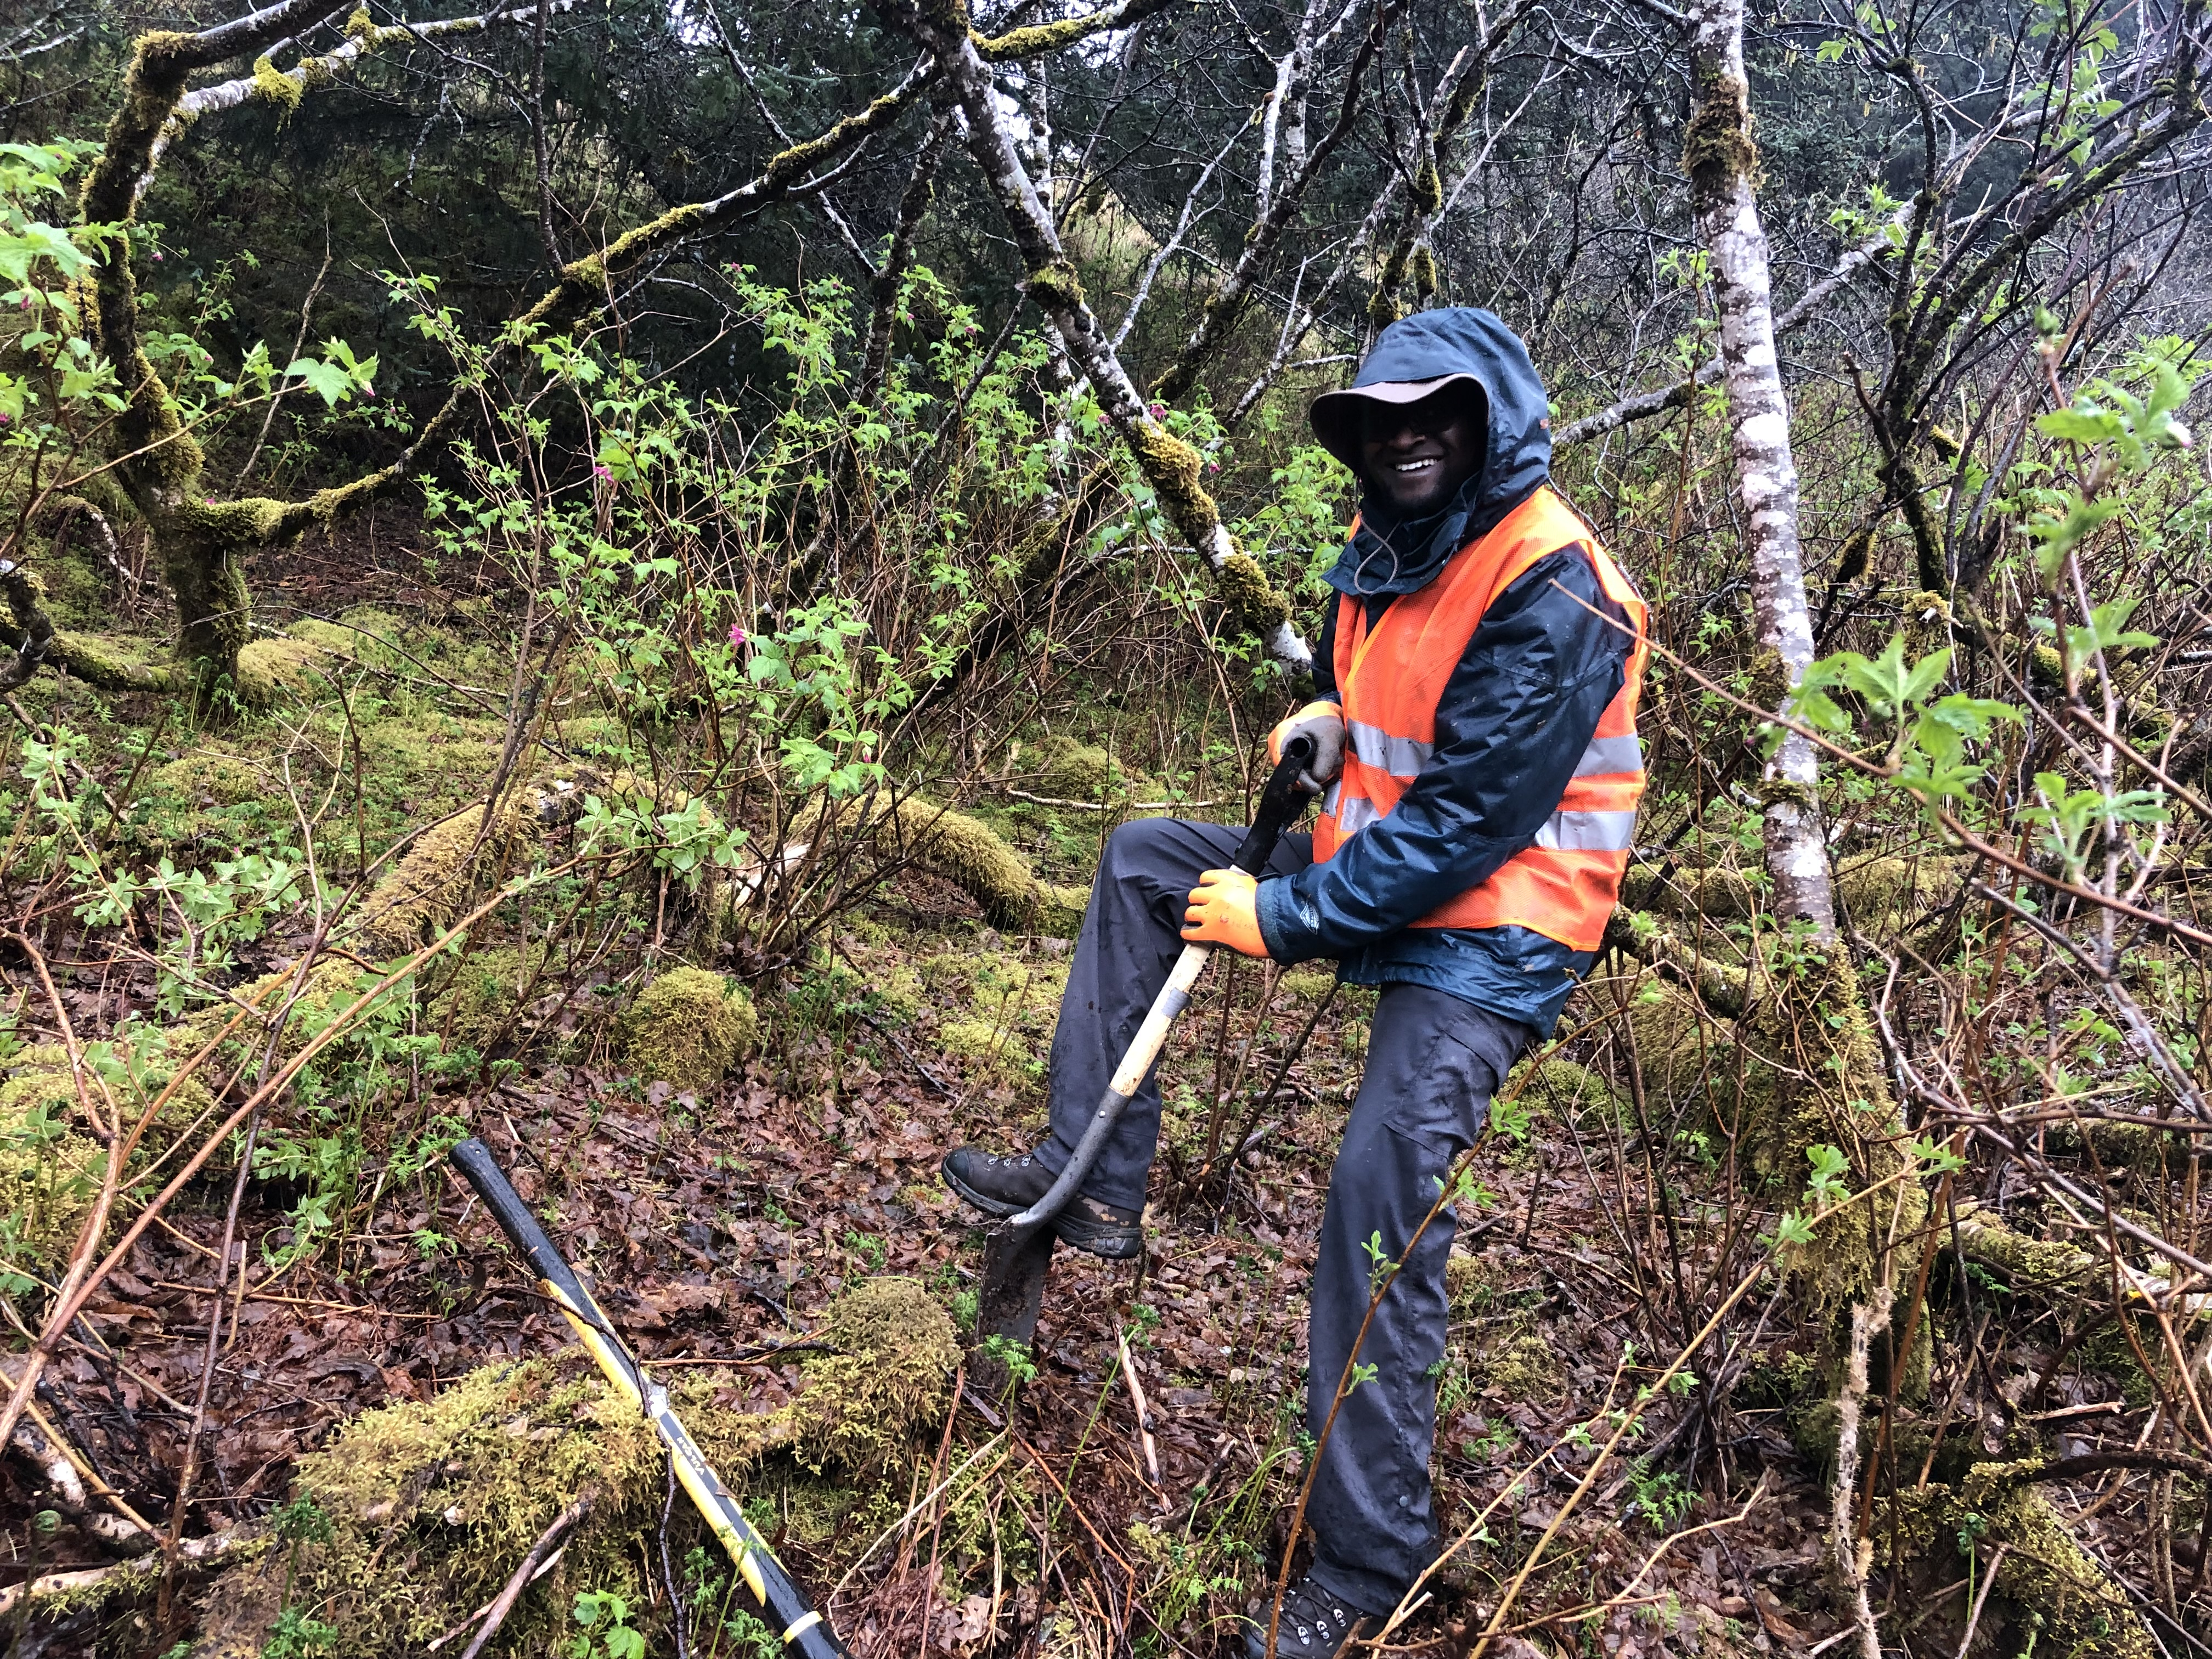
About your instructors
Evans Onyango – Graduate Student, EPS
Joined UNM in 2017.
Studies Earth's near surface with dense seismic arrays.

Slide 14
Our goals for the next two weeks:
Understand the fundamentals of geophysics
How does GPS work?
How does seismic data work?
What can we learn about the Earth with these data?
What other types of data could we gather?
Learn how to use Python for programming, data analysis and visualization
How to read and view data, make models, and more
Python is a useful & fun language to learn!
Gain confidence in your ability to program & know where to find resources
Learn about HPC (High Performance Computing) at UNM
Get lots of practice debugging and solving problems
Make some awesome figures and maps to show off your skills!

Slide 15
An overview of the agenda – Week 1
Day 1: Introduction to Python
Learn the principles of python, and write your first program
Day 2: Interacting with data, plotting, and making measurements
Learn how to use functions and scripts to import data, make nice figures, and estimate how much a GPS station moved
Day 3: Making maps and viewing spatial data
Plot your results from yesterday on a beautiful map!
Day 4: More advanced models
Modeling earthquakes with GPS data
Day 5: Field Trip!
Explore Albuquerque geology from volcanoes, to floodplains to batholiths

Slide 16
An overview of the agenda – Week 2
Day 6: Seismology and more specialized Python programming
Access and view seismic data, learn about ObsPy
Day 7: Field Trip & HPC systems
Head outside and collect some seismic data!
Learn about running your programs remotely on large servers
Day 8: Seismic Data and Group projects
Process more seismic data
Choose a topic you want to learn more about, and start preparing your projects
Day 9: Group projects
Continue working together to complete your project
Day 10: Group projects & presentations
Present your work and celebrate!

Slide 17
Logistics
Lunches: will be ordered from restaurants nearby. We’ll coordinate each day for the next few lunches
Stipend: Fill out the W-9 form and attend all days (or let us know why you have to miss a day, beforehand).
Field trips: this Friday and next Tuesday. Fill out the emergency contact form, and bring lots of water!
Computers: The lab computers here in room 115 will work, but you can use your own laptop if you prefer. Needs reasonable RAM, at least 10 GB free space and a modern operating system.
Course material: download from the course page: https://github.com/unm-escape/escape2022

Slide 18

Icebreaker! Nom-inoes
To introduce ourselves and get to know each other.

Slide 19
Icebreaker! Nom-inoes
To introduce ourselves and get to know each other.
Favorite Food
Favorite Hobby
Your Major
Name
Your 1st goal after UNM

